Slide 1
LAB 5: RED-BLACK TREES
DEPARTMENT < ... >
RESEARCH GROUP < ... >

Slide 2
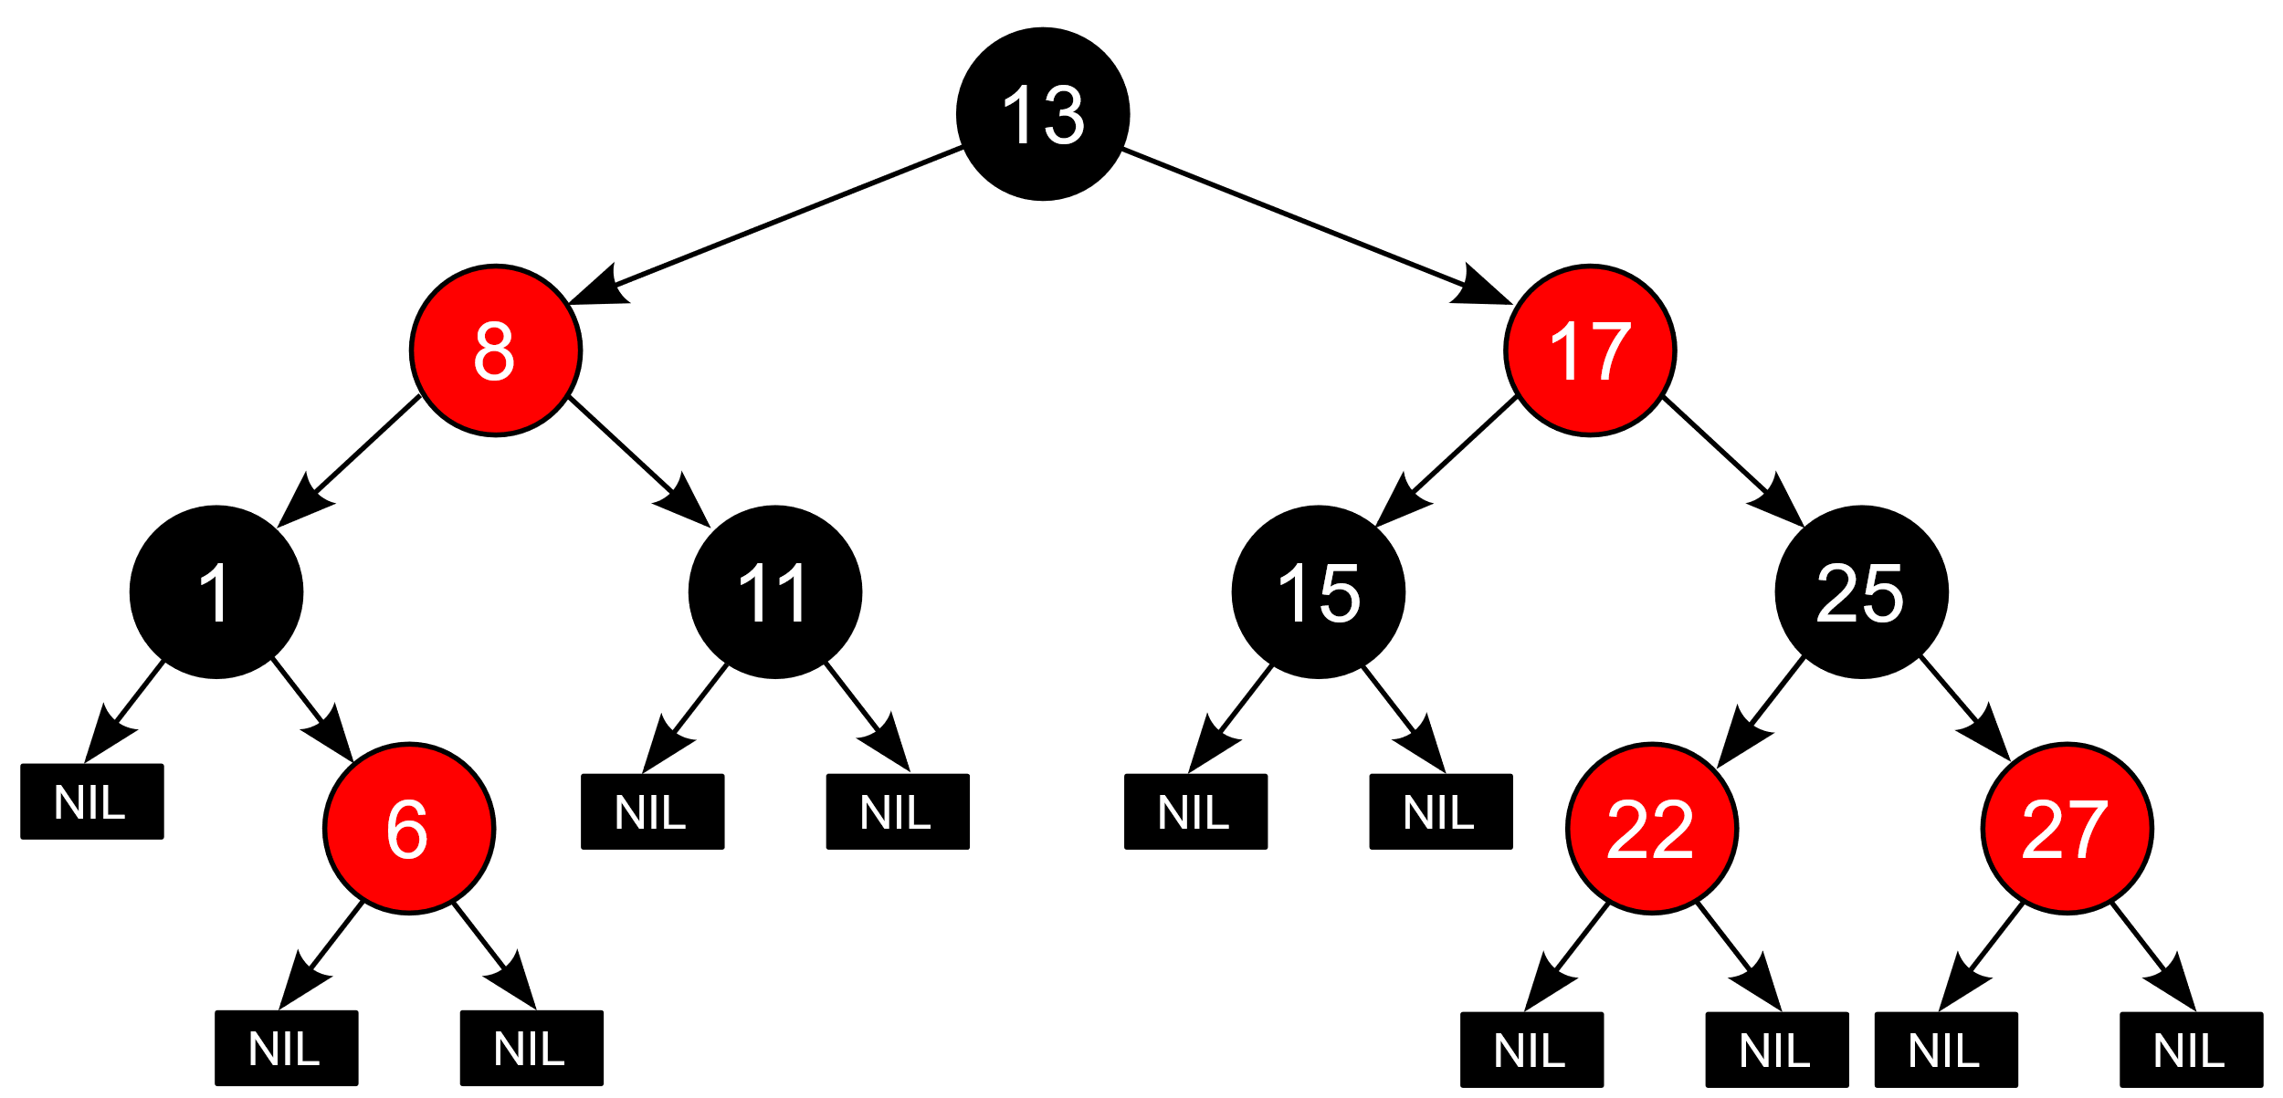
RED-BLACK TREE RULES
A node is either red or black.
The root and leaves (NULL) are black.
If a node is red, then its children are black.
All paths from a node to its NULL descendants contain the same number of black nodes.

Slide 3
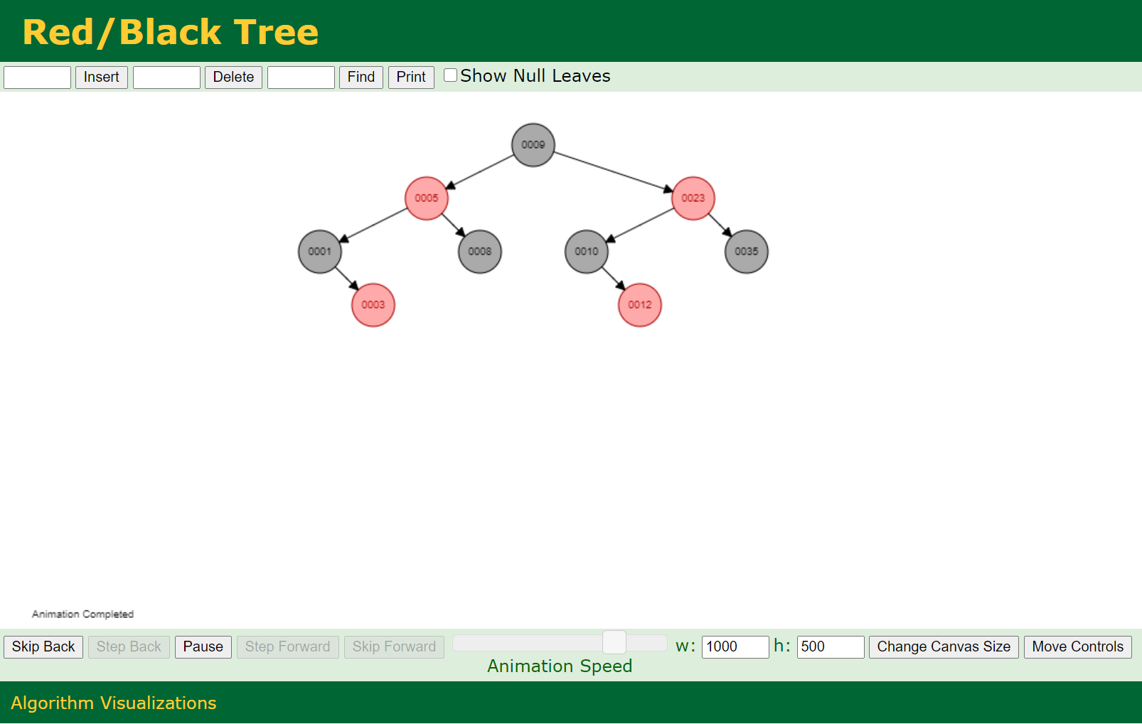
RED-BLACK TREE VISUALIZER
https://www.cs.usfca.edu/~galles/visualization/RedBlack.html

Slide 4
RECAP

Slide 5


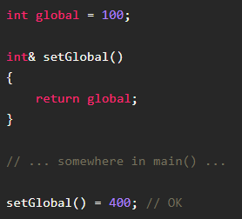
Lvalues and rvalues
lvalues: In C++ an lvalue is something that points to a specific memory location. lvalues live a longer life since they exist as variables.
rvalues: Something that doesn't point anywhere. In general, rvalues are temporary and short lived.
Here x is an lvalue and 666 is an rvalue.
Through the address-of operator &, the memory address of lvalue x is put into the lvalue y.

Slide 6

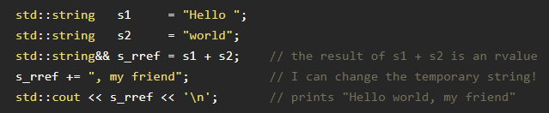
Rvalue references
In the following example, the compiler has to create a temporary object (rvalue) of the lvalues s1 and s2 to hold the result of the + operator. The result then gets placed in the lvalue s3.
rvalue references is a type that can bind to temporary objects, giving you the ability to modify them. rvalue references are denoted by placing a double ampersand && after some type.

Slide 7
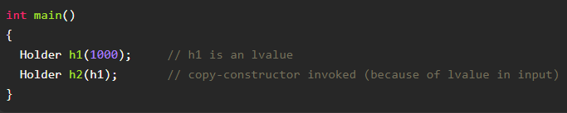
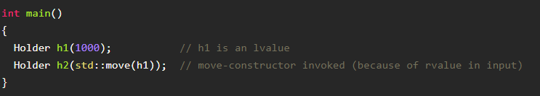
Move semantics
Move semantics is a way of moving resources around in an optimal way by avoiding unnecessary copies of temporary objects, based on rvalue references.
Instead of creating a new variable (lvalue) to pass along a temporary object, the temporary objects can be moved using rvalue references.
This requires a move constructor as well as the std::move utility function.
Std::move is used to convert an lvalue into an rvalue.

Slide 8
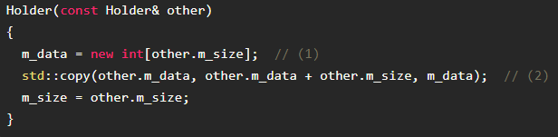
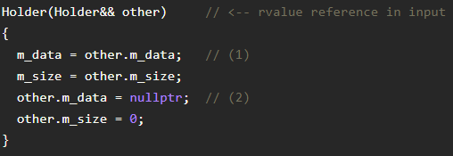
Move & copy constructor
Copy constructor:
Move constructor:

Slide 9
More information about lvalues and rvalues
https://www.internalpointers.com/post/understanding-meaning-lvalues-and-rvalues-c
https://www.internalpointers.com/post/c-rvalue-references-and-move-semantics-beginners

Slide 10
Smart pointers
Dynamically allocated memory (new) has to be released manually (delete).
Smart pointers provide automatic memory management: when it is no longer in use, it is automatically deleted.
Smart pointers wrap a normal pointer and overload the * and -> operator
Once a smart pointer goes out of scope, its destructor is called which calls delete on the inner pointer.
Three types:
std::unique_ptr: only one pointer can point to the object
std::shared_ptr: multiple pointers can point to the object, a counter keeps track of how many are active
str::weak_ptr: like shared_ptr but doesn’t increment the pointer

Slide 11


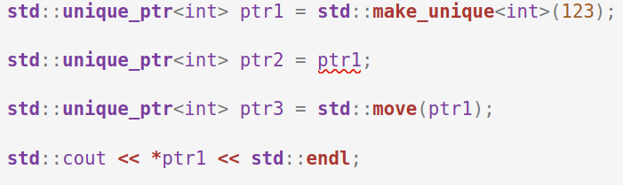
std::unique_ptr
Owns the object it points to, no other smart pointers can point to it.
Two ways to create a unique pointer
By wrapping a pointer Using make_unique (preferred)
Unique pointers can not be copied, they have to be moved:

Slide 12
More information about smart pointers
https://www.internalpointers.com/post/beginner-s-look-smart-pointers-modern-c
https://www.internalpointers.com/post/move-smart-pointers-and-out-functions-modern-c
https://en.cppreference.com/w/cpp/memory

Slide 13
Start code
Unique pointer
RZWBoom
RZWknoop
Sleutel
Ouder
Links, rechts
Kleur

